Slide 1
Scientific Research in Information Systems
Chapter 2
Information Systems Research as a Science
JAN RECKER

Slide 2
Overview
Information Systems Research as a Science
Principles of Scientific Inquiry
Natural Sciences vs. Social Sciences
Body of Knowledge
The Scientific Method
Essential Concepts in Information Systems Research
Further Reading

Slide 3
Principles of Scientific Inquiry
The goal of scientific inquiry is to discover laws and propose theories that can explain [natural or social, tangential or latent] phenomena in the worlds that concern us.
The key principles of scientific research:
1. The research work contributes to a body of knowledge.
2. The research work conforms to the scientific method.
Science is the attempt to derive knowledge from facts through certain methods in a systematic and organized way.
Two categories of science:
Natural Sciences
Social Sciences
Obj. 1.2

Slide 4
Natural Sciences vs. Social Sciences
Natural sciences concern the study of naturally occurring phenomena and include such fields of inquiry such as chemical sciences, physical sciences, life sciences, and the biological sciences.
Social sciences concern the study of people or collections of people and include sciences such as psychology, sociology, organizational science and economics.
The natural sciences (also referred to as ‘exact sciences’) rely on precise and accurate measurements of phenomena or their properties while the social sciences are even further away from precision.
Measurement error is invariably present in the social sciences.
Notes:
Note: A discipline that concerns information technology in use by [individuals/organisations/ economies/other groups of people], by definition, is a part of the social sciences. (As soon as our investigation concerns a human element, imprecision, vagueness and ambiguity creeps into our research.)

Slide 5
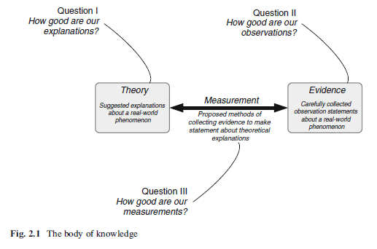
Body of Knowledge
The outcome of all research to date, is the current accumulation of theories, evidence, and measurement methods in a certain domain.

Slide 6
Body of Knowledge (Cont.)
Three ways of contributing to the body of knowledge:
We can improve our explanation of a particular phenomenon. (Theory)
Example: research on theories explaining why people accept or reject information technology over time
We can improve our collections of scientific evidence. (Evidence)
Example: the famous voyage of Darwin on the Beagle, where he encountered and systematically described many previously unknown species ofplants and animals.
We can better our methods for collecting observations in relation to theory (Measurement).
Example: Galileo made a telescope with about 3 x magnification and later made improved versions with up to about 30 x magnification.
Notes:
We can improve the current accumulation of theories, evidence and measurement methods in a certain domain. (Please see figure in previous slide).

Slide 7
Scientific Method
The scientific method describes a body of techniques and principles for investigating real-world phenomena with the view to adding to the body of knowledge.
The scientific method postulates that the inquiry must be based on gathering empirical and measurable evidence subject to specific principles of reasoning.
Scientific inquiry is generally intended to be as objective as possible, to reduce bias.
To ensure as much objectivity in research as possible, several principles are provided by the scientific method as a sort of checklist:
Replicability
Independence
Precision
Falsification
Notes:
Replicability is a term that characterises the extent to which research procedures are repeatable.
Independence is closely related to reliability. It concerns the extent to which the research conduct is impartial and freed from any subjective judgment or other bias stemming from the researcher or research team itself.
The precision principle states that in all scientific research the concepts, constructs, and measurements should be as carefully and precisely defined as possible to allow others to use, apply, and challenge the definitions, concepts, and results in their own work.
Falsification describes the logical possibility than an assertion, hypothesis, or theory can be contradicted by an observation or other outcome of a scientific study or experiment.
The falsification argument has at least two important implications.
First, it draws a clear boundary around the possibilities of scientific research: our theories are sets of suggested explanations that are assumed to be true because the evidence collected to date does not state otherwise.
Second, falsification also implies an important criterion for the theories that are created as scientific output: a good scientific theory is one that can be falsified.

Slide 8
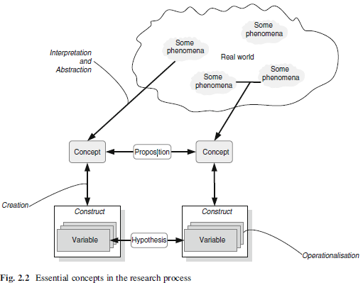
Essential Concepts in Information Systems Research

Slide 9
Essential Concepts in Information Systems Research (Cont.)
A concept describes an abstract or general idea inferred or derived from specific instances that we perceive in the real world.
Example
real phenomena (dogs, clouds, pain)
some latent phenomena that we can agree upon (truth, beauty, prejudice, usefulness, value, and so forth)
Propositions (also called a conceptual hypothesis) are proposals for an explanation about how phenomena are related.
Example
Education increases income. (The concepts of education and income are, by definition, abstract and could have many meanings.)
A construct is the creation of an operationalisation of a concept in a way that we can define it in terms of how we can measure the construct.
Example
Education → “highest degree earned“ (high school, under-graduate, post-graduate)
Income → “Yearly Salary“
Two types of constructs: uni-dimensional (ex. gender) vs. multidimensional (ex. intelligence)
Notes:
Concepts can be linked to one another via propositions.
hypotheses are suggested linkages between constructs
Intelligence, for example, can hardly be measured by one variable only, because we understand this concept to pertain to abilities for abstract thought, understanding, communication, reasoning, learning, planning, problem solving and others, including emotional intelligence.

Slide 10
Essential Concepts in Information Systems Research (Cont.)
A variable is thus the empirical indicator that allows us to approximate the underlying latent construct. It is a measurable representation or manifestation of a latent construct in the real world.
Example
when we define the concept “weight” as the construct describing the force on an object due to gravity, then we can define a measurement variable that specifies different levels of weight, for instance, using a metric scale (in kilograms).
Hypothesis is the empirical formulation of a proposition that is characterized as a testable relationship between two or more variables.
Example
Weak hypothesis: “highest degree earned is related to annual gross salary“
(no directionality, no causality)
Strong hypothesis: “the higher the degree earned, the more annual gross salary will be earned“
Notes:
For example, “highest degree earned is related to annual gross salary” is what we call a weak hypothesis, because it fails to specify directionality (does the earning of a degree cause an increase or decrease in annual gross salary?) or causality (does annual gross salary cause a specific degree or vice versa?). A strong hypothesis, by contrast, would be the statement “the higher the degree earned, the more annual gross salary will be earned”. As this example shows, hypotheses need to clearly specify directionality as well as causality by clearly delineating which variables lead to which effect on which other variable.

Slide 11
Further Reading
Chalmers, A.F.: What Is This Thing Called Science? 3rd edn. Hackett, Indianapolis (1999)
Popper, K.R.: The Logic of Scientific Discovery. Basic Books, New York (1959)
Feyerabend, P.: Against Method, 3rd edn. Verso, New York (1993)
Bhattacherjee, A.: Social Science Research: Principles, Methods and Practices, 2nd edn. Global Text Project, Tampa (2012)
Creswell, J.W.: Research Design: Qualitative, Quantitative, and Mixed Methods Approaches, 3rd edn. Sage, Thousand Oaks (2009)
Reynolds, P.D.: A Primer in Theory Construction. Allyn and Bacon, Needham Heights (1971)
Cronbach, L.J., Meehl, P.E.: Construct validity in psychological tests. Psychol. Bull. 52, 281–302 (1955)

Slide 12
Thank You ☺

